Slide 1



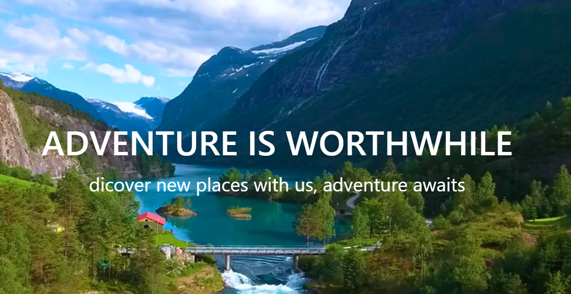
KNOW-IT, C-DAC ACTS (ATC), Pune
Project Group : 24
210943020015 Shubham Dattatraya Borude
210943020061 Omkar Manojkumar Dubal
210943020097 Akanksha Dnyandeo Sonawane
210943020103 Tanvi Jahagirdar
Guided By Prof. Monika Shivankar

Slide 2
CONTENTS
Project Introduction
Project Architecture
Technology platforms used for project
User Roles and responsibilities
Use Case Diagrams
DFD - 0
Division of work within team
Future Scope
Conclusion

Slide 3
INTRODUCTION
1. Purpose of the Project :
The purpose is to build a system that performs all operations related to traveling, booking, sightseeing, etc.
Tourism has changed quite a lot over the last few years. Maps on paper have shifted to Google Maps. Everything is designed to make our travels as hassle-free and as easy as possible. But travelling is more than just packing your backs and just going somewhere. previously people were not able to do all the booking at one place. They needed to contact various agencies for various bookings.
This project will come with some solution that going to solve lots of problems like a tourist can book his holiday packages before leaving the own house.

Slide 4
GOAL OF PROJECT
The purpose is to build a system that performs all operations related to traveling, booking, sightseeing, etc.
This system connects customers and agents directly, provides a feedback mechanism for tourists, maintains and controls the database of tourists’ information, and gives a variety of travel services.
The purpose is to design a system using which one can perform all operations related to traveling and sight-seeing.
The system allows one to easily access the relevant information. It is a dynamic and responsive system which let users to decide about places they want to visit and make bookings online for travel and accommodation

Slide 5
Project Architecture
Used for
User Interfacing
Basic data validation
Used for
Server side validations
Response handling
Business logic
database operations
Front end layer
Used for
Permanent data storage
Database level validations
Server layer
Techonologies used
React JS
Bootstrap
Technologies used
Java
Spring boot REST API
JPA
Database layer
Technologies used
MySQL

Slide 6
Technology platform used for project
1. Front End Layer
Technologies used-
React JS
Bootstrap
Reasons-
React JS- One of the main benefits of using React JS is its potential to reuse components. It saves time for developers as they don't have to write various codes for the same features. Furthermore, if any changes are made in any particular part, it will not affect other parts of the application.
Bootstrap-Time Saving, Easy to Use, Responsive Grid System, Customizable, Cross-Browser Compatibility, Establish Consistency, Open-Source.

Slide 7
Technology platform used for project
2. Server Layer
Technologies Used - Java, Spring boot - REST API, JPA
Reason-
Java- Java is easy to learn. Java was designed to be easy to use and is therefore easy to write, compile, debug, and learn than other programming languages.
Java is object-oriented. This allows you to create modular programs and reusable code.
Spring boot REST API- A few benefits of using Spring Boot for your REST APIs include: No requirement for complex XML configurations. Embedded Tomcat server to run Spring Boot applications. An auto-configuration feature by Spring Boot that configures your application automatically for certain dependencies.

Slide 8
Technology platform used for project
2. Server Layer :
JPA- The main advantage of JPA over JDBC for developers is that they can code their Java applications using object-oriented principles and best practices without having to worry about database semantics.

Slide 9
Technology platform used for project
3. Database Layer
Technologies used-
MySQL
Reason- It is open source, reliable, compatible with all major hosting providers, cost-effective, and easy to manage. Many organizations are leveraging the data security and strong transactional support offered by MySQL to secure online transactions and enhance customer interactions

Slide 10
User Roles and Responsibilities
User Roles -
Admin
Customer
Responsibilities for each user –
Admin:- Create new package, Add new package, Delete new package
Customer:- Register and create his own account, Book Tour.

Slide 11
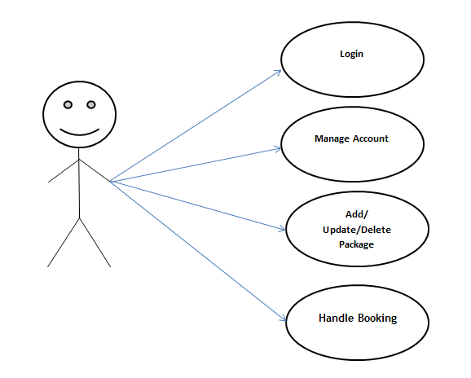
Use Case Diagram : Admin

Slide 12
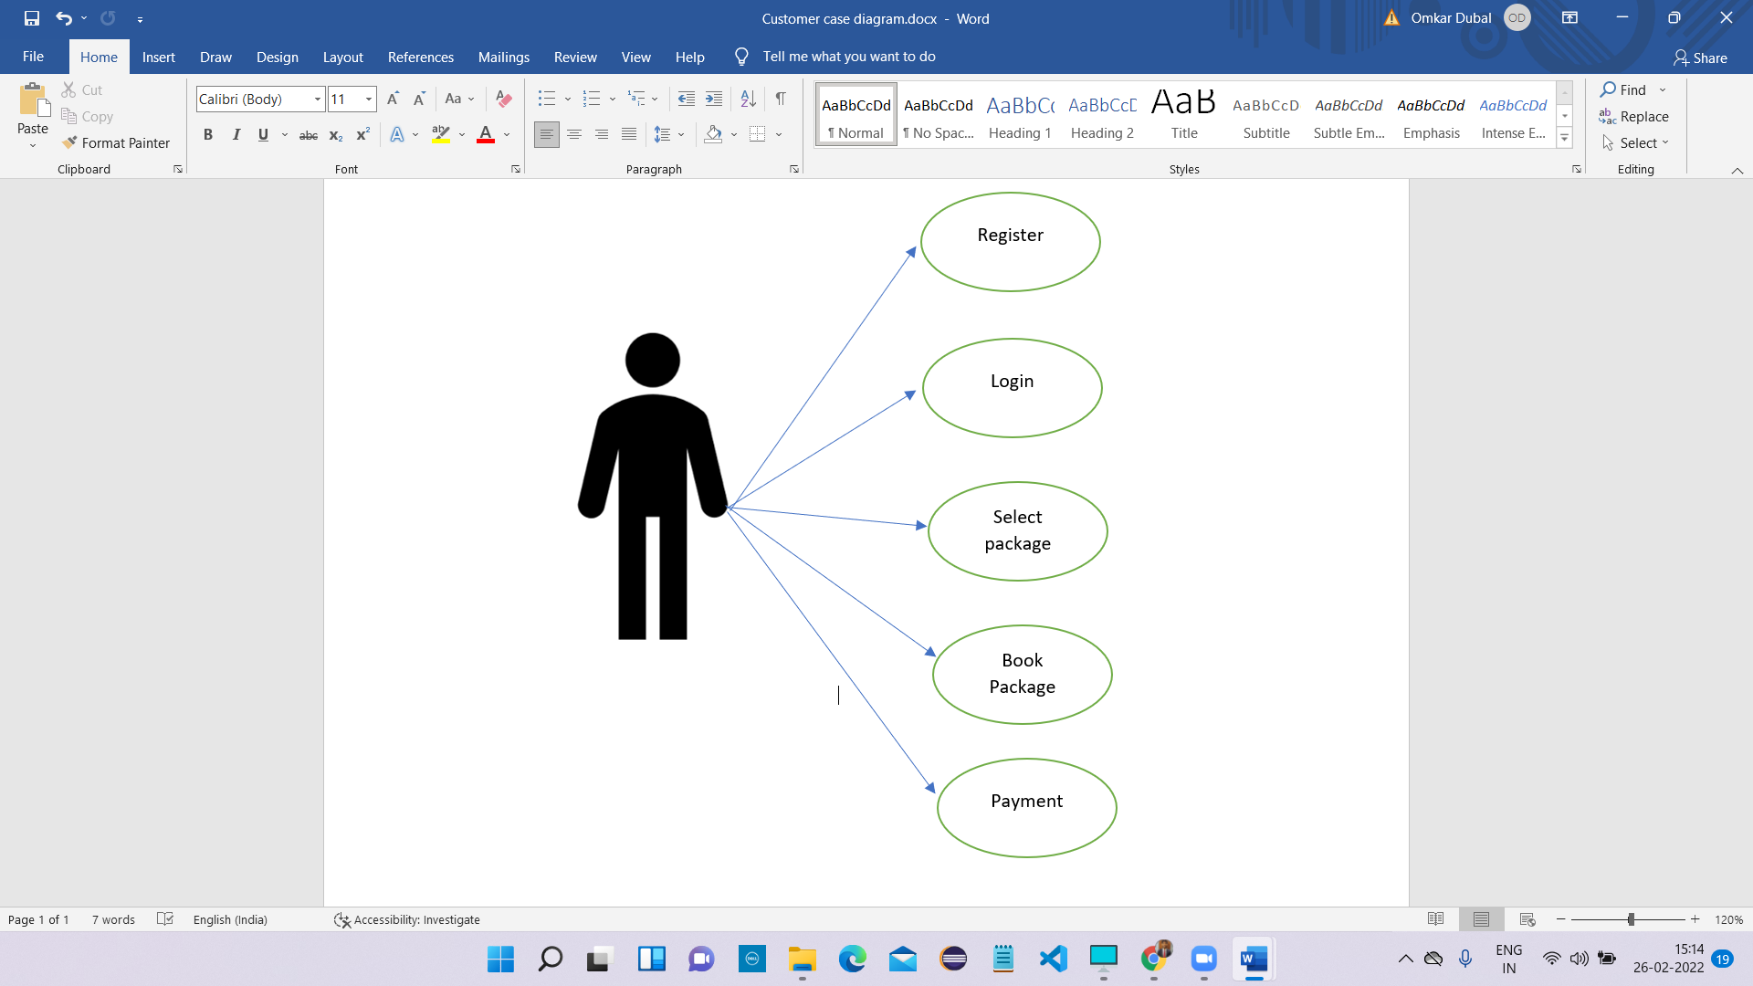
Use Case Diagram : Customer

Slide 13
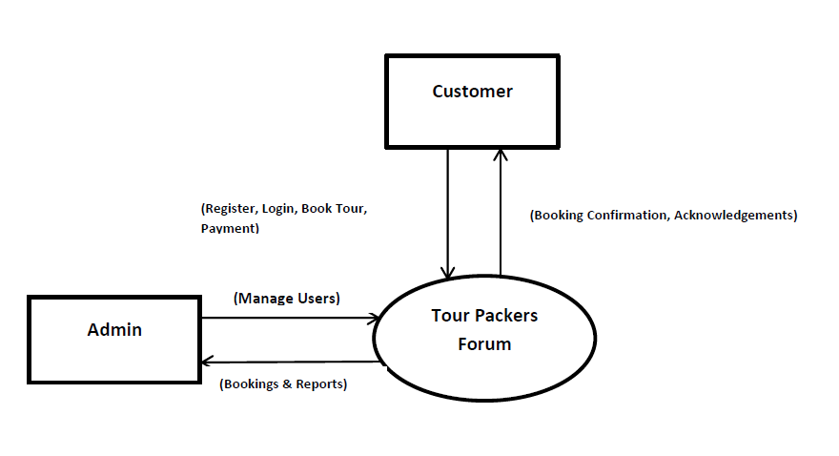
[DFD 0]

Slide 14
Details of Team Contribution
Shubham : FrontEnd & Backend – Login, Registration, DataBase Design
Omkar : FrontEnd & Backend – Booking, MainMenu, DataBase Design
Akanksha : FrontEnd :Contact , Backend : Contact, DataBase Design
Tanvi : About Page

Slide 15
Future Scope
In the aspect of tourism, Internet and web technologies have made more readily available information on tourist locations, accommodations, transportation, shopping, food, festivals, and other attractions, thus improving the whole tourism experience.
In the upcoming years we may add some features like Hotel Booking, Transportation, User Customized Packages, etc.

Slide 16
Conclusion
This web application was successfully created and stored all the tourism packages, booking data, creation of new tours packages along with tour details into the Tour Packer’s database.
The application was tested very well and the errors were properly debugged. Unit testing also concluded that the performance of the system is satisfactory. All the necessary output is generated. This system thus provides an easy way to automate all the functionalities of consumption.

Slide 17
THANK YOU
For your valuable time.

